Slide 1
Encore Tickets
Humberto Arana, Zain Husain, Michael Lyke, Keaton May
April 23, 2019

Slide 2
Business Overview
Encore Tickets allows customers to:
Browse lists of:
Performers
Events
Venues
Tickets
Purchase tiered tickets
Purchase add-ons
Register to a membership

Slide 3
Next Level Funding
By 2023 the worldwide ticket industry will:
Be a $105 Billion Market [1]
Be used by 1.1 Billion Customers [1]
In the US alone: 8.3% annual growth [2]
Expanding Encore Tickets to accommodate Cinematic and Sports events will increase revenue.

Slide 4
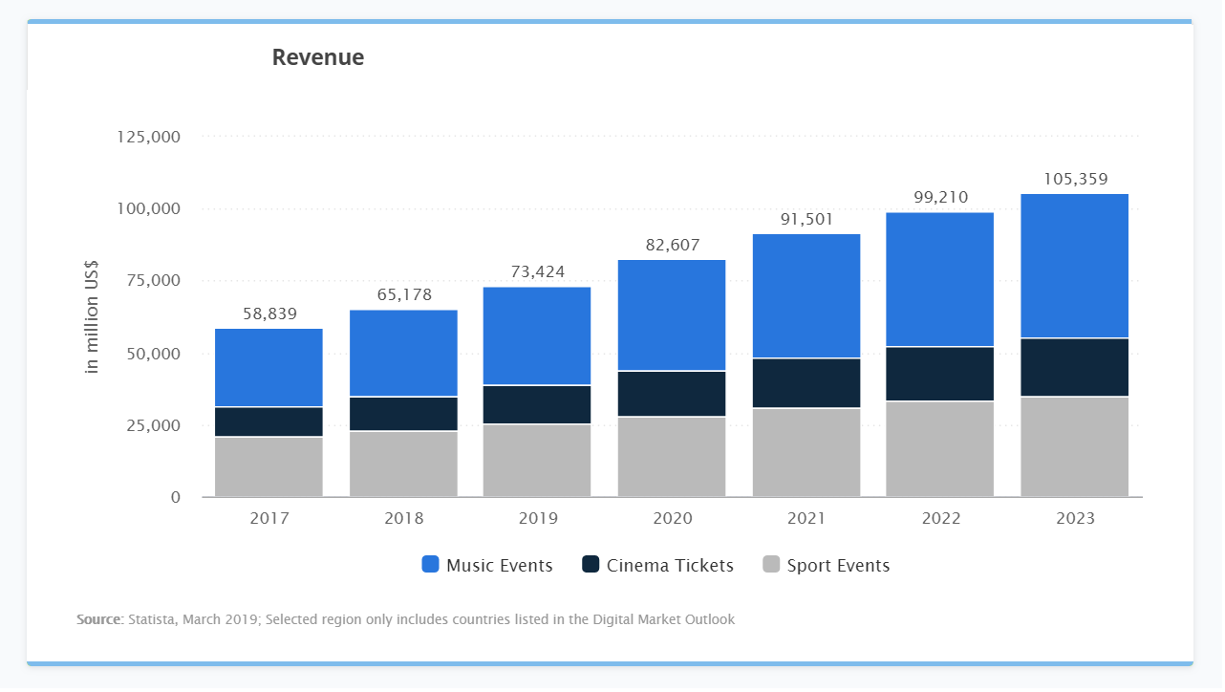
[1]

Slide 5
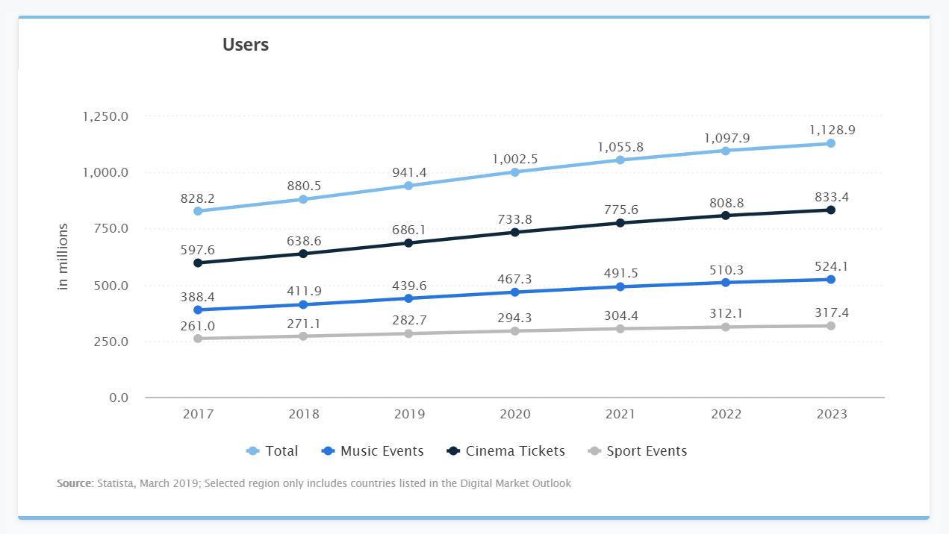
[1]

Slide 6
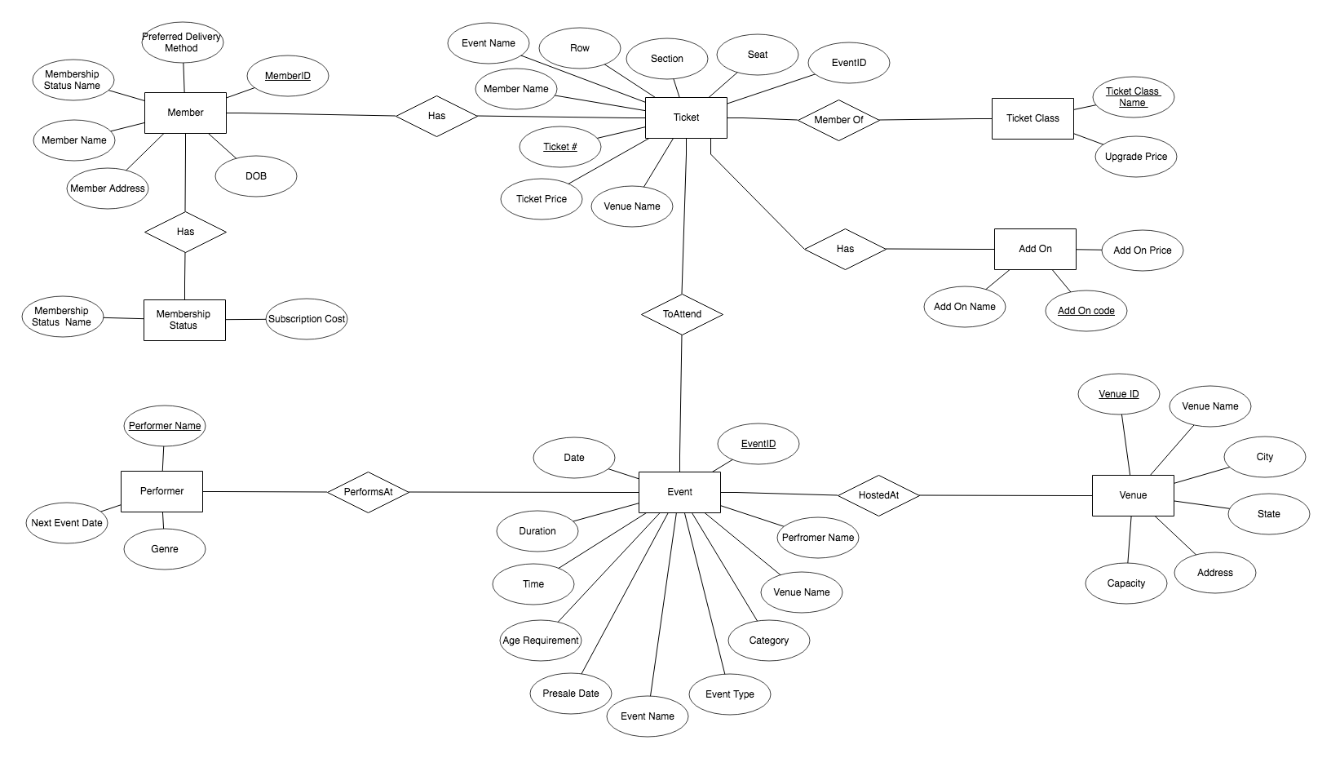
Data model - ERD

Slide 7
Data Model - Schema
Event
EventID | EventType | EventName | EventDate | EventTime | Duration | VenueID | PerformerName | AgeReq | Category | PresaleDate
Venue
Venue ID | Venue Name | Address | Next Performer | Next Event Date
Ticket
TicketNumber | EventID | VenueID | MemberID | Section | Row | Seat | TicketPrice | TicketClassName | Add-onCode
Member
Member ID | Member Name | Address | Phone Number | DOB | Preferred Delivery Method | Membership Status Name

Slide 8
Schema (continued)
Performer
Performer Name | Genre
Ticket Class
Ticket Class Name | Upgrade Price
Add-On
Add-On Code | Add-On Name | Add-On Price
Membership Status
Status name | Subscription Cost

Slide 9
Problems and Solutions
Data generation
Thought we could automate, but were unable to
Ended up writing out all data and insert statements by hand
Queries
Kept generating spurious tuples
Took several attempts to arrive at queries that generated the response we were looking for
Insertions
Getting errors
Had to go through all hand written insertions and eventually found the errors

Slide 10
Conclusion

Slide 11
References
[1] “Event Tickets Worldwide” (statista) [Online]. Available: https://www.statista.com/outlook/264/100/event-tickets/worldwide (Accessed: April 17, 2019).
[2] “Online Event Ticket Sales Industry in the US,” (ibisworld) [Online]. Available: https://www.ibisworld.com/industry-trends/specialized-market-research-reports/online-retail/lifestyle-services/online-event-ticket-sales.html (Accessed: April 18, 2019).

